Slide 1
SE: Synopsis Presentation
By
Dhruv Kudale 111607034
Vatsal Unadkat 111603074
February 2019

Slide 2
Abstract
Running is a very common sport among millions of people. It’s an effective form of exercise but due to the lack of motivation a lot of people struggle to start running. Thereby the purpose of the android application would be to help them to look forward to start running whether it is their first time or trying to develop or maintain it as a habit. It also focuses to keep them engaged and focus on improving their pace time.

Slide 3
Introduction
The Run Android Application would be to help runners to look forward to start running whether it is their first time or trying to develop/maintain it as a habit. It also focuses to keep them engaged and focus on improving their pace time. The application will benefit runners and lazy runners in improving their pace. The application will adjust the music according to the BPM value of the runner. The application will enhance everyday running activity and also give an enhanced running experience. This will in turn motivate reluctant runners to run and have a better performance

Slide 4
Literature Review
The comparative study consists of 14 research papers related to the topics of pedometer accuracy and music prediction with their advantages, disadvantages and particular accuracy.
Many researches are done in the past decades related to smartphone pedometer accuracy, music prediction algorithms, tags research, psychological effects of music on running, etc in the journals published in the field of statistics, smartphones, devices, sensors, physical fitness, sports and exercise, music, psychology, etc.

Slide 5
Research Papers
Accuracy of a smartphone pedometer application
Smartphone pedometers are more accurate(2-6kmph) and equally accurate above 6kmph to physical pedometers
Pedometers to promote physical activity
Pedometers have been used successfully to to promote activity among youth

Slide 6
Research Papers
Effect of walking speed in determining pedometer accuracy
Newer pedometers are more accurate than older ones for moderate speeds only but not for very slow and very fast speeds
Music auto-tagging using deep Recurrent Neural Networks
Accuracy increases with increase in the number of layers. 5 layer RNN was more accurate than that of 4 layer one

Slide 7
Research Papers
Tag-Aware Dynamic Music Recommendation
A model is developed to determine evolution of preferences of users, making the overall recommendation time sensitive and hence more accurate.
Humans are able to self-paced constant running accelerations
Runners are able to control and maintain subjective accelerations until exhaustion for about 1 min 36s to 20 min

Slide 8
Research Papers
Comparison of Several Algorithms to Estimate Activity Counts
Algorithm 4 of measuring direct area under accelerometer curve gave the highest accuracy (minimum RMSE)
Pedometer-Measured Physical Activity
Pedometers with a standard metric are one of the few valid, reliable and accurate measures of youth physical activity

Slide 9
Research Papers
Effects of synchronous music on treadmill running among elite triathletes
Music presence benefits by increasing mood responses, time to exhaustion by 18.1 to 19.7 percent and reduces RPE
The effect of music type on running perseverance and coping with effort sensations
Right type (inspirational) music can benefit running as 63 percent participants felt motivated during many phases of the run

Slide 10
Research Papers
A novel method for personalized music recommendation
Users may be not interested in highly rated music and cannot recommend the music which is not rated by anyone
How Accurate are Pedometer Cell Phone Applications
The majority of applications evaluated in this study, did not show high accuracy

Slide 11
Research Papers
Expert Systems with Applications
A lot of factors were taken into consideration such as age, gender, height, weight, BMI, body fat %, etc
Influence of non-level walking on pedometer accuracy
Exhibited good accuracy during incline walking up to 10%.

Slide 12
Contribution
Dhruv Kudale
7 Research papers mostly related to pedometers and psychological effects of music on running
Preparation of Synopsis using Texmaker
Vatsal Unadkat
7 Research papers mostly related to music prediction methods and GPS tracking.
Preparation of data flow diagram and elaborating methodological implementation

Slide 13
Research Gaps
Following points mention the narrow domains of which limited, insufficient research is made which eventually restricts the ability to answer or conclude aspects related to the matter.
Pedometer research in Android (particular) applications
Habit of repeated recommendation for users apart from the ones users have been used to listen or for that of a segment of smaller duration
Verification of the accuracy from an external source with respect to music prediction
Inclusion of young individuals with spontaneous and free running tests who are currently occupied in sedentary lifestyle or exercise less than thrice a week

Slide 14
Objectives
The aim is to induce positive atmosphere that will motivate beginners as well as runners with decent stamina to improve and maintain the habit of this basic physical activity.Following are one of the main objectives
To predict and deliver the most suitable track for the runner in the ongoing phase of the run so as to keep the runner engaged in the process assuming that appropriately suggested music should produce faster running performance.
To make a reliable pedometer that displays relevant, tactful and accurate pace reading and other statistics that will broadly enhance the mind of the runner during the run.
To enable consideration of calendar events or festivals for favourable recommendation for the users.

Slide 15
Methodology
The music recommendation system and the reliable pedometer are one of the major highlights of this project. Following figure shows a schematic analysis of the application with the user or runner point of view.
User will start running and during various phases of running the music recommendation system will suggest suitable track of dynamic duration based on the BPM value of the runner in order to improve the performance.For acheiving this, (although not a compulsory requirement) a database of the past runs with split timings per kilometer could help the application for its music predictions. The personal playlist of the user would also be of good help which can be added to the music database.
The pedometer will keep into account the required statistical information pertaining to the phase, real time improvement and changes occuring in the pace, target speed analysis,etc.

Slide 16
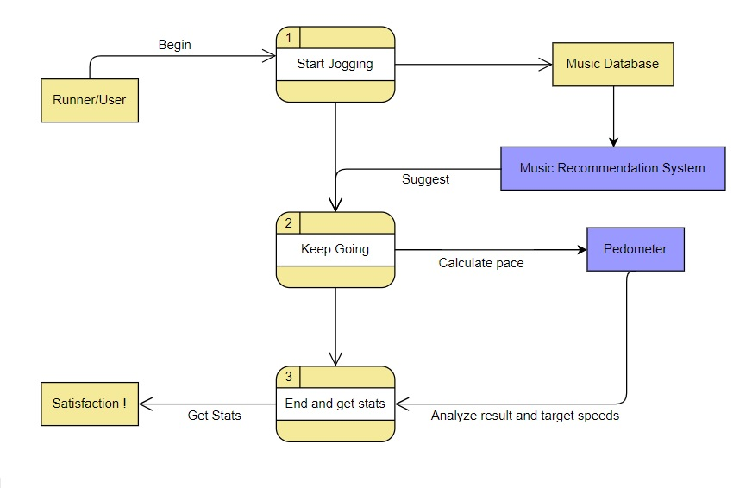
Consider events

Slide 17
Conclusion
In this project, the aim is to develop an application that will motivate the runners to perform better.Android platform is used to implement this application. Every person nowadays posseses an android cell phone hence the reason. The application aims to induce some beneficial physical activity motivation (here in running) accompanied with proper, spontaneous and encouraging music suggestions which will direct in expanding the sedentary life of various young individuals.

Slide 18
Thank You

